Slide 1
Process Scheduling

Slide 2
Thread Vs. Process
What is the difference between a thread and a process?

Slide 3
Thread Vs. Process
What is the difference between a thread and a process?
A thread is contained within a process

Slide 4
Preemptive Vs. Nonpreemptive
What is the difference in Preemptive and nonpreemtive schedulers?

Slide 5
Preemptive Vs. Nonpreemptive
What is the difference in Preemptive and nonpreemtive schedulers?
Preemptive schedulers will context switch out a process that is currently running in response to an external event.

Slide 6
Throughput
What is throughput?
What is average turnaround time?
What is average waiting time?

Slide 7
Throughput
What is throughput?
A measure of the number of jobs executed per unit time.
What is average turnaround time?
A measure of the average elapsed time for jobs entering and leaving the system
What is average waiting time?
The average time spent waiting by all of the processes

Slide 8
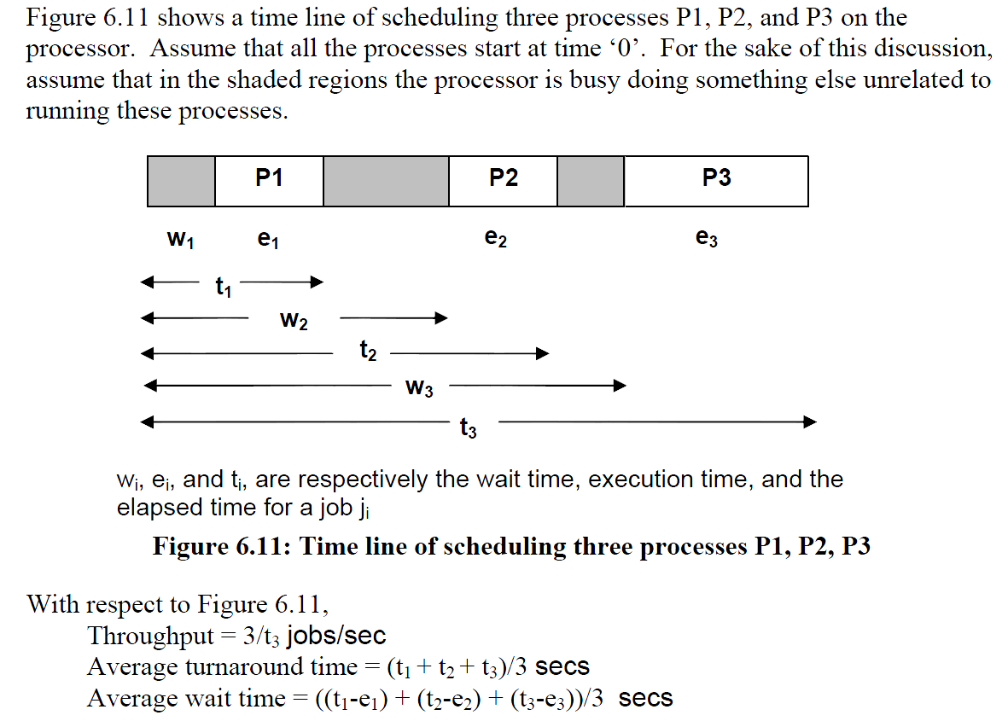

Slide 9
Starvation
What is starvation and what algorithms are vulnerable to starvation?

Slide 10
Starvation
What is starvation and what algorithms are vulnerable to starvation?
Starvation is the chance that a process will never run.
Algorithms vulnerable to starvation are SJF and Priority
Algorithms not vulnerable are FIFO and Round Robin

